Slide 1
計算物理概論 期末專題報告
小組名稱：蔡期超級神
9922212 王郁傑
9930125 許智鈞
101022118 蔡期超
101022119 陳 寧
101022127 謝明皓

Slide 2
題目：震盪系統的模擬
理論力學的簡諧振子是物理中的經典問題
我們將討論以下的問題：
線性震盪：$\ddot{x}+{ω_{0}}^{2}x=0$
線性震盪的位能圖和相位圖
線性阻尼震盪：$\ddot{x}+2β\dot{x}+ {ω_{0}}^{2}x=0$
強迫震盪： $\ddot{x}+2βx+ {ω_{0}}^{2}x=Acosωt$

Slide 3
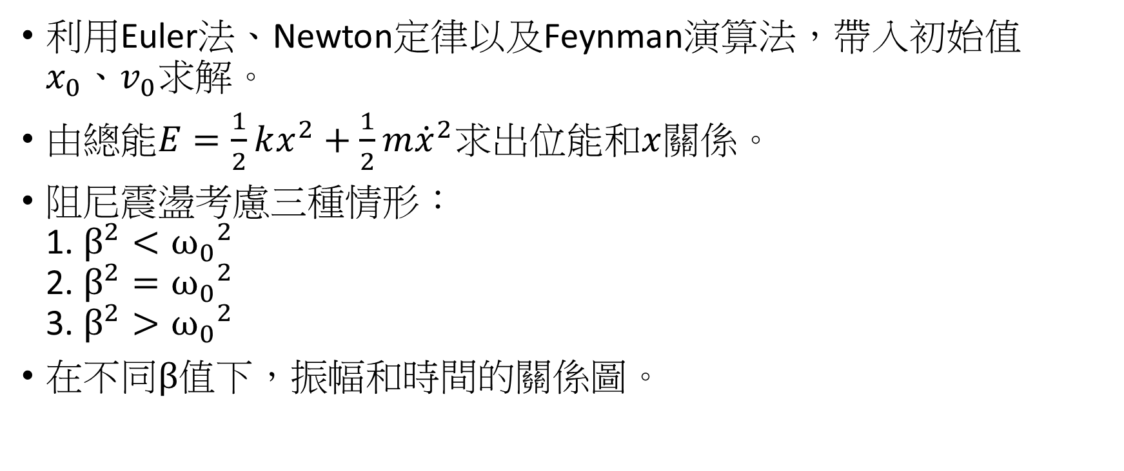
探討方式
利用Euler法、Newton定律以及Feynman演算法，帶入初始值$x_{0}、v_{0}求解。$
由總能$E=\frac{1}{2}kx^{2}+\frac{1}{2}m{\dot{x}}^{2}$求出位能和$x$關係。
阻尼震盪考慮三種情形： 1. $β^{2}<{ω_{0}}^{2}$ 2. $β^{2}={ω_{0}}^{2}$ 3. $β^{2}>{ω_{0}}^{2}$
在不同$β$值下，振幅和時間的關係圖。

Slide 4
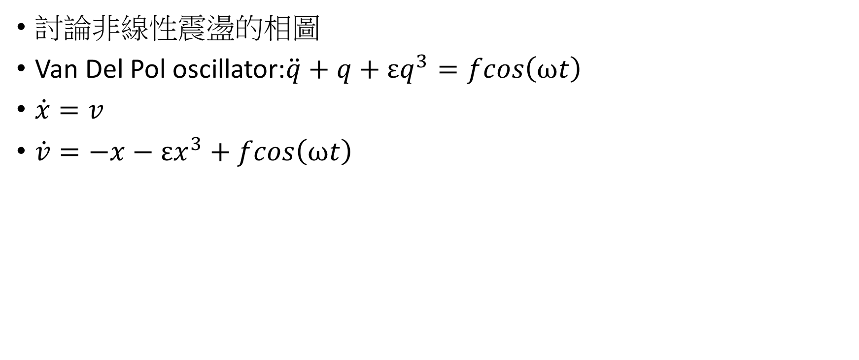
延伸探討：加入非線性項的混沌效應
討論非線性震盪的相圖
Van Del Pol oscillator:$\ddot{q}+q+εq^{3}=fcos\left(ωt\right)$
$\dot{x}=v$
$\dot{v}=−x−εx^{3}+fcos\left(ωt\right)$

Slide 5
初始參數
初始位置 Xo=0.754682
初始速度 Vo=-59.7952
ω=2

Slide 6
Simple Harmonic Oscillator: Code 1
#Harmonic oscillator
#dx/dt=v
#dv/dt=-w*w*x
#x(t+h)=x(t)+h*v(t+h/2)
#v(t+h/2)=v(t-h/2)+h*a(t)
#v(1/2)=v0+(h/2)a0
from pylab import*
from math import*
x0=0.754682
v0=-59.7952
w=2
t=0 #initial time
h=0.001 #time step size

Slide 7
Simple Harmonic Oscillator: Code 2
xdat=[]
vdat=[]#velocity data store here
time=[]#time stored here
v0=v0+h*(-w*w*x0)/2
while(t<=100):
x1=x0+h*v0
v1=v0+h*(-w*w*x1)
xdat.append(x1)
vdat.append(v1)
time.append(t)
x0=x1
v0=v1
t=t+h

Slide 8
Simple Harmonic Oscillator: Code 3
figure(1)
title("Harmonic oscillator motion")
xlabel(" Time")
ylabel("x")
plot(time,xdat)
grid(True)
figure(2)
title("Harmonic oscillator motion")
xlabel("Time")
ylabel("Velocity")
plot(time,vdat)
grid(True)

Slide 9
Simple Harmonic Oscillator: Code 4
figure(3)
title("Harmonic oscillator motion")
xlabel("x")
ylabel("Velocity")
plot(xdat,vdat)
grid(True)
show()
print "(%g,%g)" % (xdat[T],vdat[T])

Slide 10
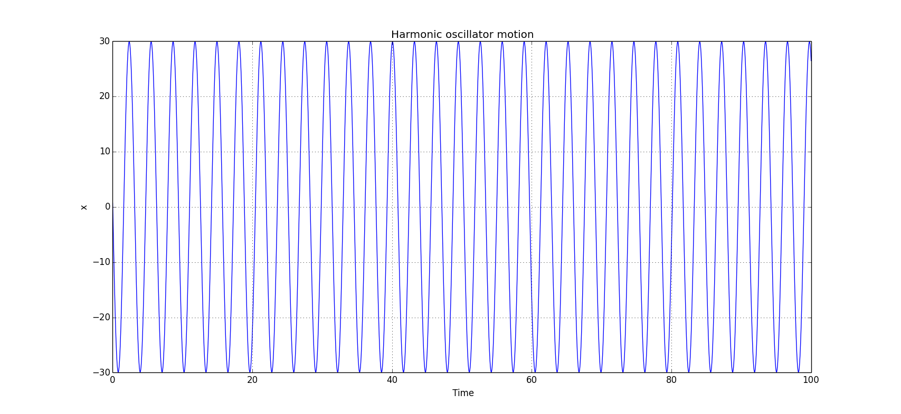
Simple Harmonic Oscillator: x-t Plot

Slide 11
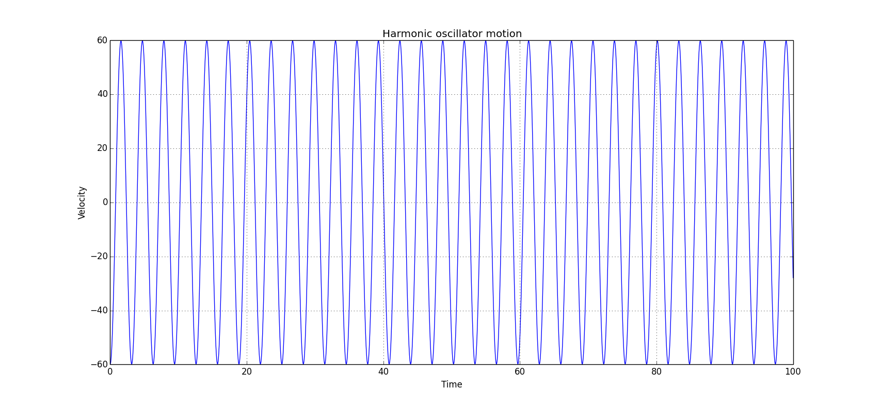
Simple Harmonic Oscillator: v-t Plot

Slide 12
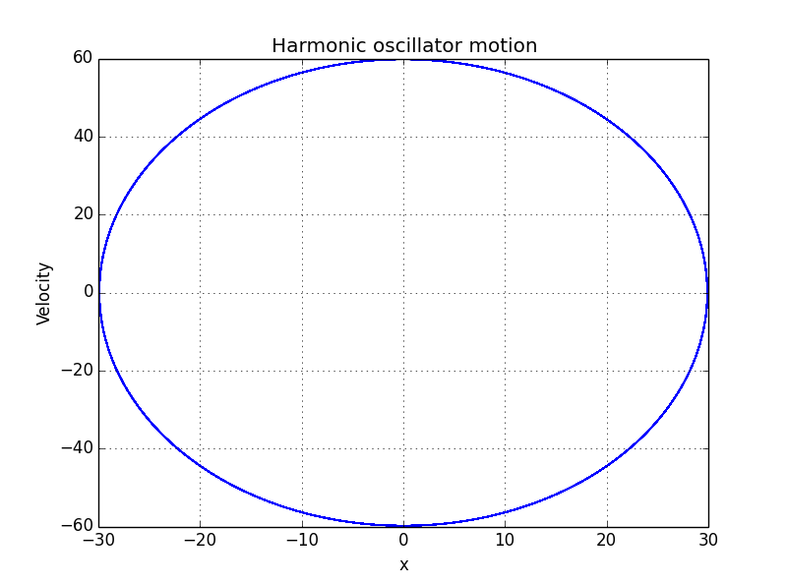
Simple Harmonic Oscillator: Phase Diagram

Slide 13
Lissajous Curves: Code 1
from pylab import*
from math import*
x0=10
v0=0
w=math.pi
F=50
Q=0.05
t=0 #initial time
h=0.001 #time step size
T=500 #time interval
N=T/h #data number

Slide 14
Lissajous Curves: Code 2
xdat=[]
vdat=[]#velocity data store here
time=[]#time stored here
driven=[]
driven1=[]
v0=v0+h*(-x0-v0/Q)/2

Slide 15
Lissajous Curves: Code 3
while(t<=T-200):
x1=x0+h*v0
v1=v0+h*(-x1-v0/Q+math.cos(w*t))
x0=x1
v0=v1
t=t+h
while(t<=T):
x1=x0+h*v0
v1=v0+h*(-x1-v0/Q+math.cos(w*t))
p=w*t
a=math.cos(p)

Slide 16
Lissajous Curves: Code 4
xdat.append(x1)
vdat.append(v1)
time.append(t)
driven.append(a)
x0=x1
v0=v1
t=t+h
figure(4)
title("Lissajous")

Slide 17
Lissajous Curves: Code 5
xlabel("x")
ylabel("F")
plot(xdat,driven)
grid(True)
show()

Slide 18
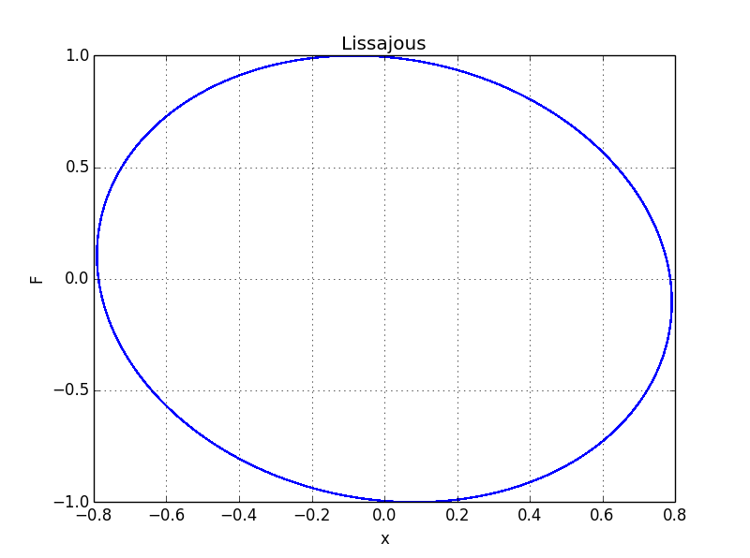
Lissajous Curve: Phase Diagram

Slide 19
Damping Harmonic Oscillator: Code 1
from pylab import*
from math import*
x0=10
v0=20
w=2
b=4
t=0 #initial time
h=0.01 #time step size

Slide 20
Damping Harmonic Oscillator: Code 2
xdat=[]
vdat=[]#velocity data store here
time=[]#time stored here
v0=v0+h*(-w*w*x0-b*v0)/2
while(t<=100):
x1=x0+h*v0
v1=v0+h*(-w*w*x1-b*v0)

Slide 21
Damping Harmonic Oscillator: Code 3
xdat.append(x1)
vdat.append(v1)
time.append(t)
x0=x1
v0=v1
t=t+h
figure(1)
title("Damped harmonic oscillator motion")
xlabel(" Time")
ylabel("x")
plot(time,xdat)
grid(True)

Slide 22
Damping Harmonic Oscillator: Code 4
figure(2)
title("Damped harmonic oscillator motion")
xlabel("Time")
ylabel("Velocity")
plot(time,vdat)
grid(True)
figure(3)
title("Damped harmonic oscillator motion")

Slide 23
Damping Harmonic Oscillator: Code 5
xlabel("x")
ylabel("velocity")
plot(xdat,vdat)
grid(True)
show()

Slide 24
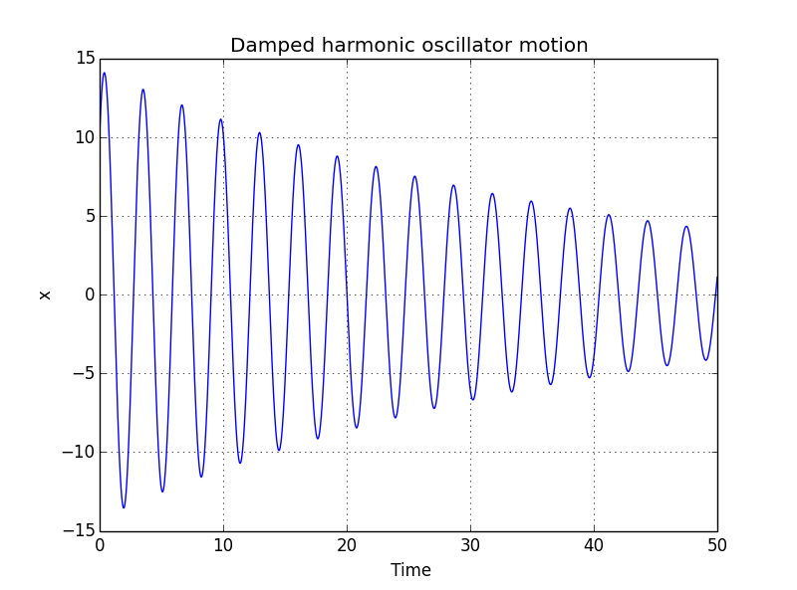
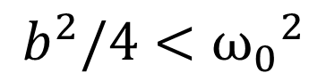
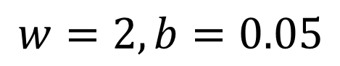
Damping Harmonic Oscillator: Underdamping Motion: x-t Plot
$$w=2, b=0.05$$
$$b^{2}/4<{ω_{0}}^{2}$$

Slide 25
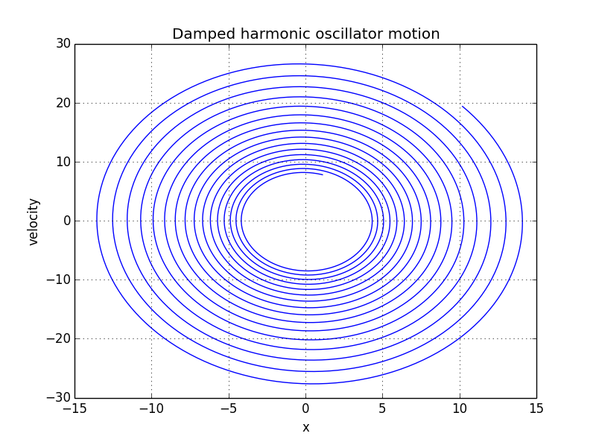
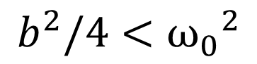
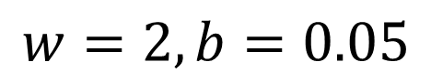
Damping Harmonic Oscillator: Underdamping Motion: Phase Diagram
$$w=2, b=0.05$$
$$b^{2}/4<{ω_{0}}^{2}$$

Slide 26
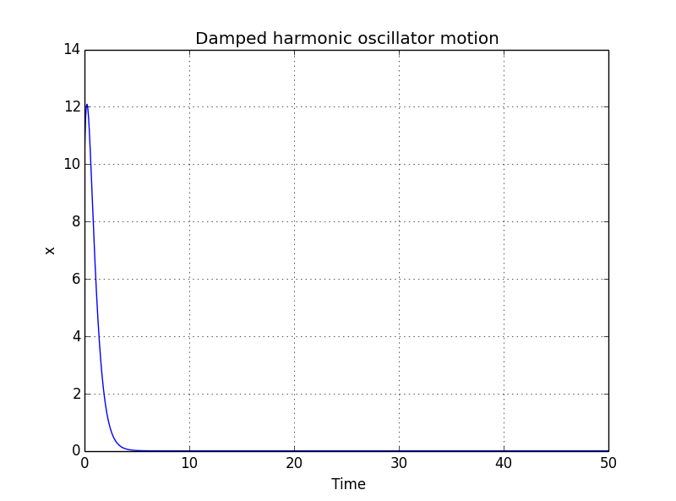
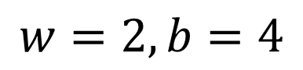
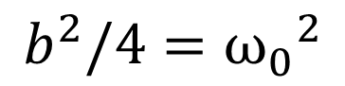
Damping Harmonic Oscillator: Critically damping Motion: x-t Plot
$$w=2, b=4$$
$$b^{2}/4={ω_{0}}^{2}$$

Slide 27
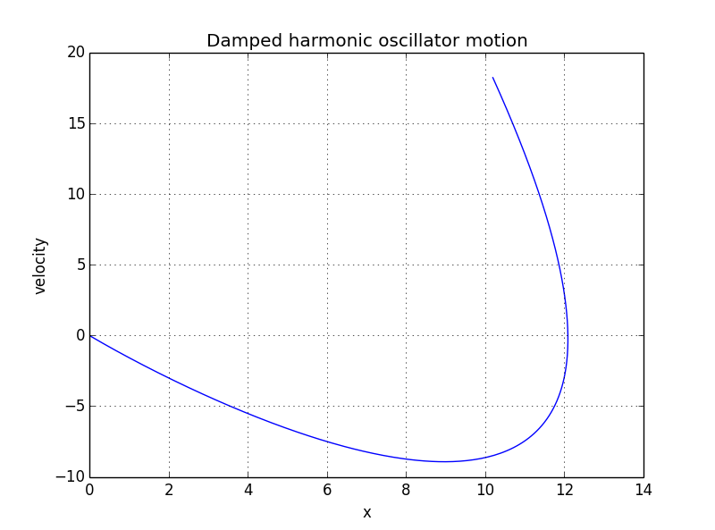
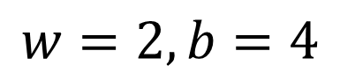
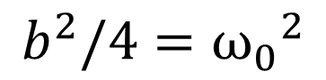
Damping Harmonic Oscillator: Critically damping Motion: Phase Diagram
$$w=2, b=4$$
$$b^{2}/4={ω_{0}}^{2}$$

Slide 28
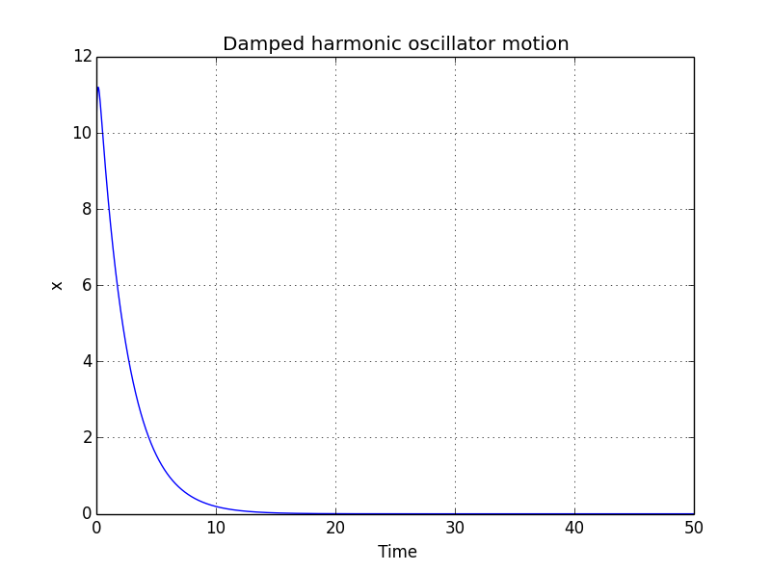
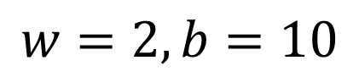
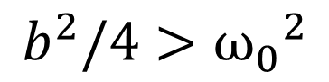
Damping Harmonic Oscillator: Overdamping Motion: x-t Plot
$$w=2, b=10$$
$$b^{2}/4>{ω_{0}}^{2}$$

Slide 29
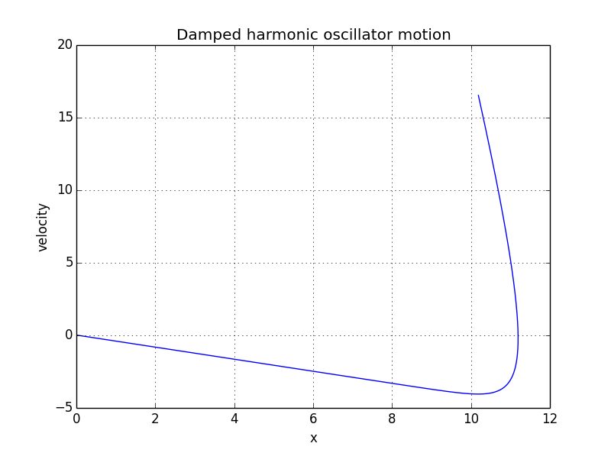
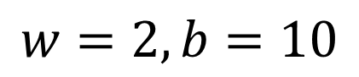
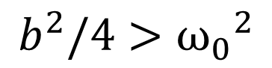
Damping Harmonic Oscillator: Overdamping Motion: Phase Diagram
$$w=2, b=10$$
$$b^{2}/4>{ω_{0}}^{2}$$

Slide 30
Driven Harmonic Oscillator: Code 1
from pylab import*
from math import*
x0=10
v0=20
w=2
w0=2
b=10
t=0 #initial time
h=0.01 #time step size
F=100

Slide 31
Driven Harmonic Oscillator: Code 2
xdat=[]
vdat=[]#velocity data store here
time=[]#time stored here
v0=v0+h*(-w*w*x0-b*v0+F*math.cos(w0*t))/2
while(t<=50):
x1=x0+h*v0
v1=v0+h*(-w*w*x1-b*v0+F*math.cos(w*t))

Slide 32
Driven Harmonic Oscillator: Code 3
xdat.append(x1)
vdat.append(v1)
time.append(t)
x0=x1
v0=v1
t=t+h
figure(1)
title("Driven harmonic oscillator motion")
xlabel(" Time")
ylabel("x")
plot(time,xdat)
grid(True)

Slide 33
Driven Harmonic Oscillator: Code 4
figure(2)
title("Driven harmonic oscillator motion")
xlabel("Time")
ylabel("Velocity")
plot(time,vdat)
grid(True)
figure(3)
title("Driven harmonic oscillator motion")

Slide 34
Driven Harmonic Oscillator: Code 5
xlabel("x")
ylabel("velocity")
plot(xdat,vdat)
grid(True)
show()

Slide 35
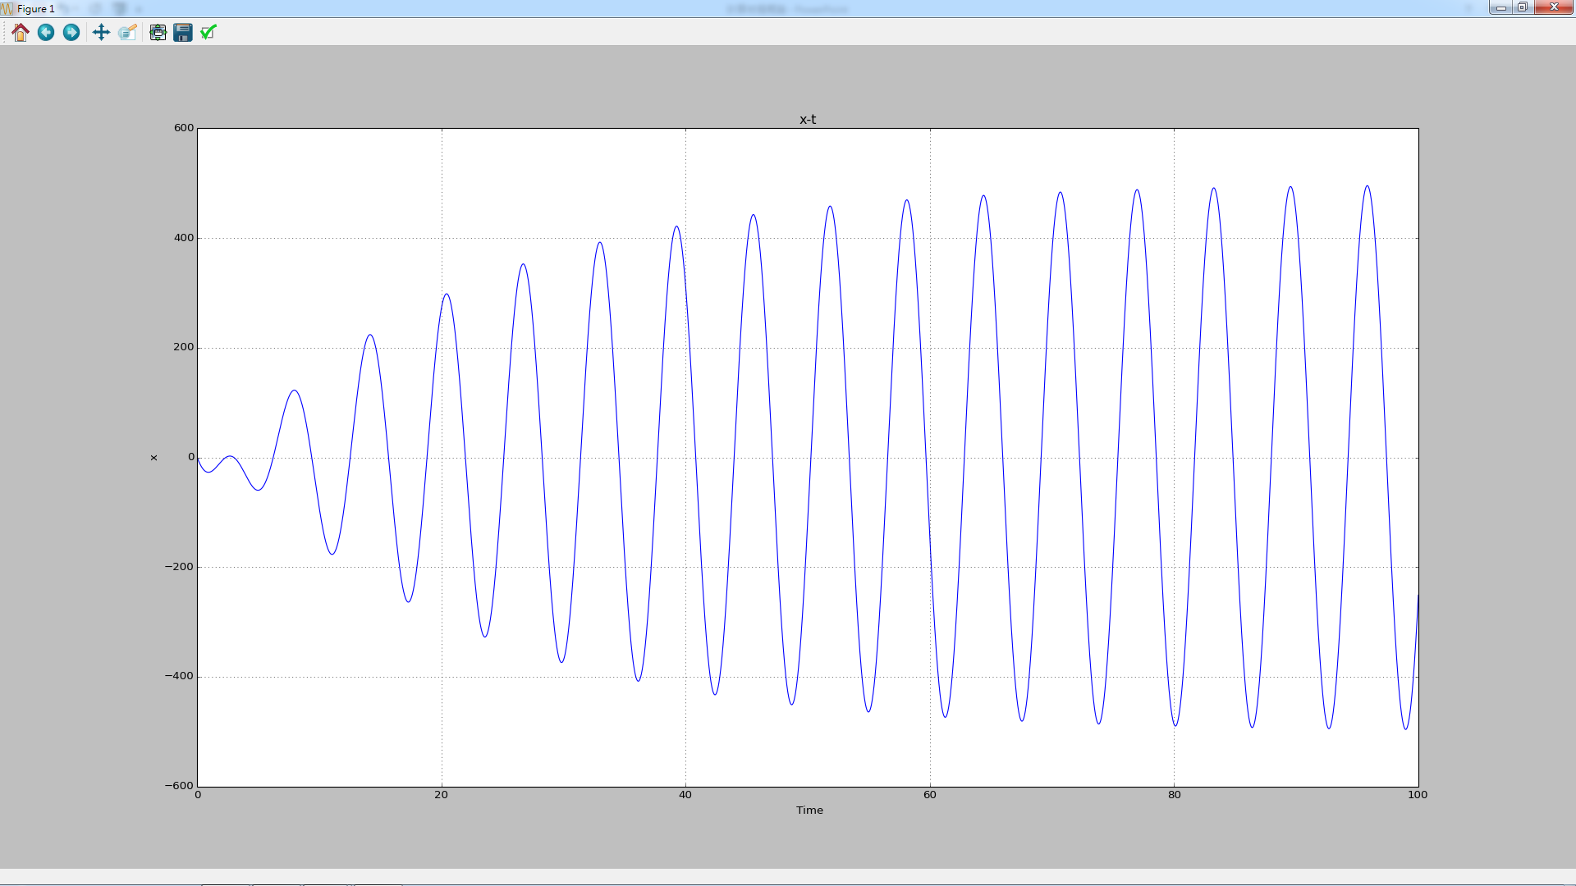

Driven SHM $ω=ω_{0}$

Slide 36
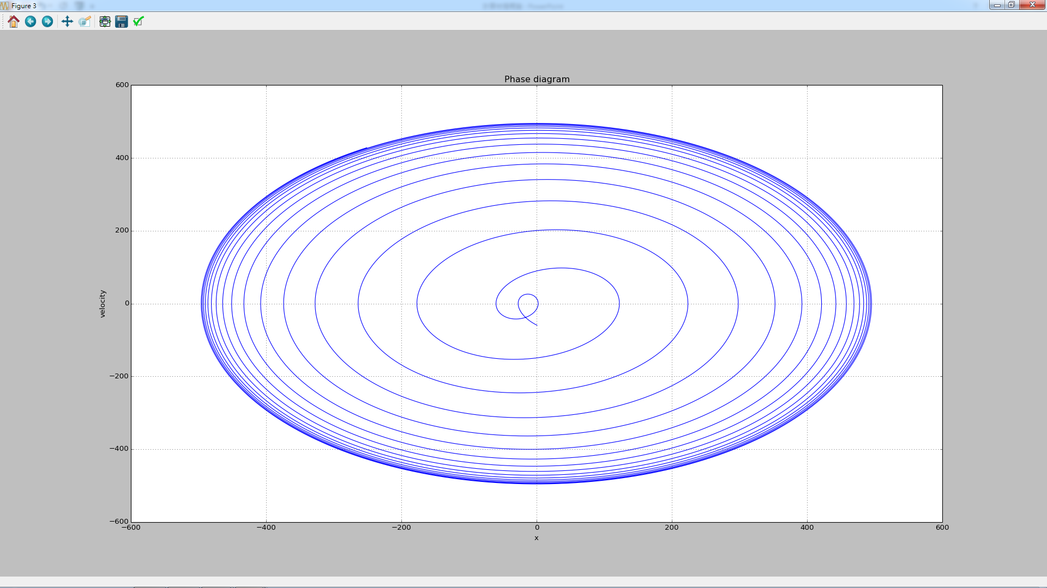
Driven SHM $ω=ω_{0}$

Slide 37
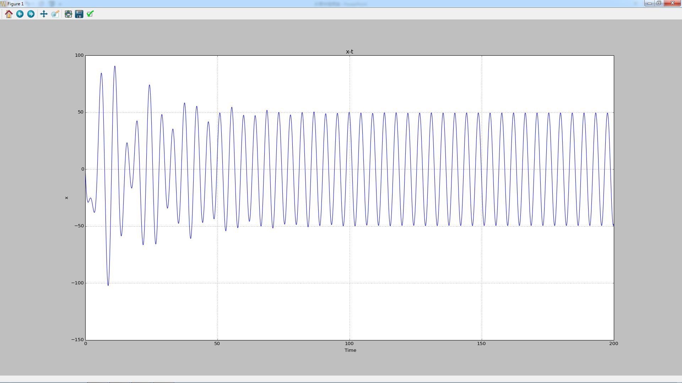

Driven SHM $ω=\frac{1}{\sqrt{2}}ω_{0}$

Slide 38
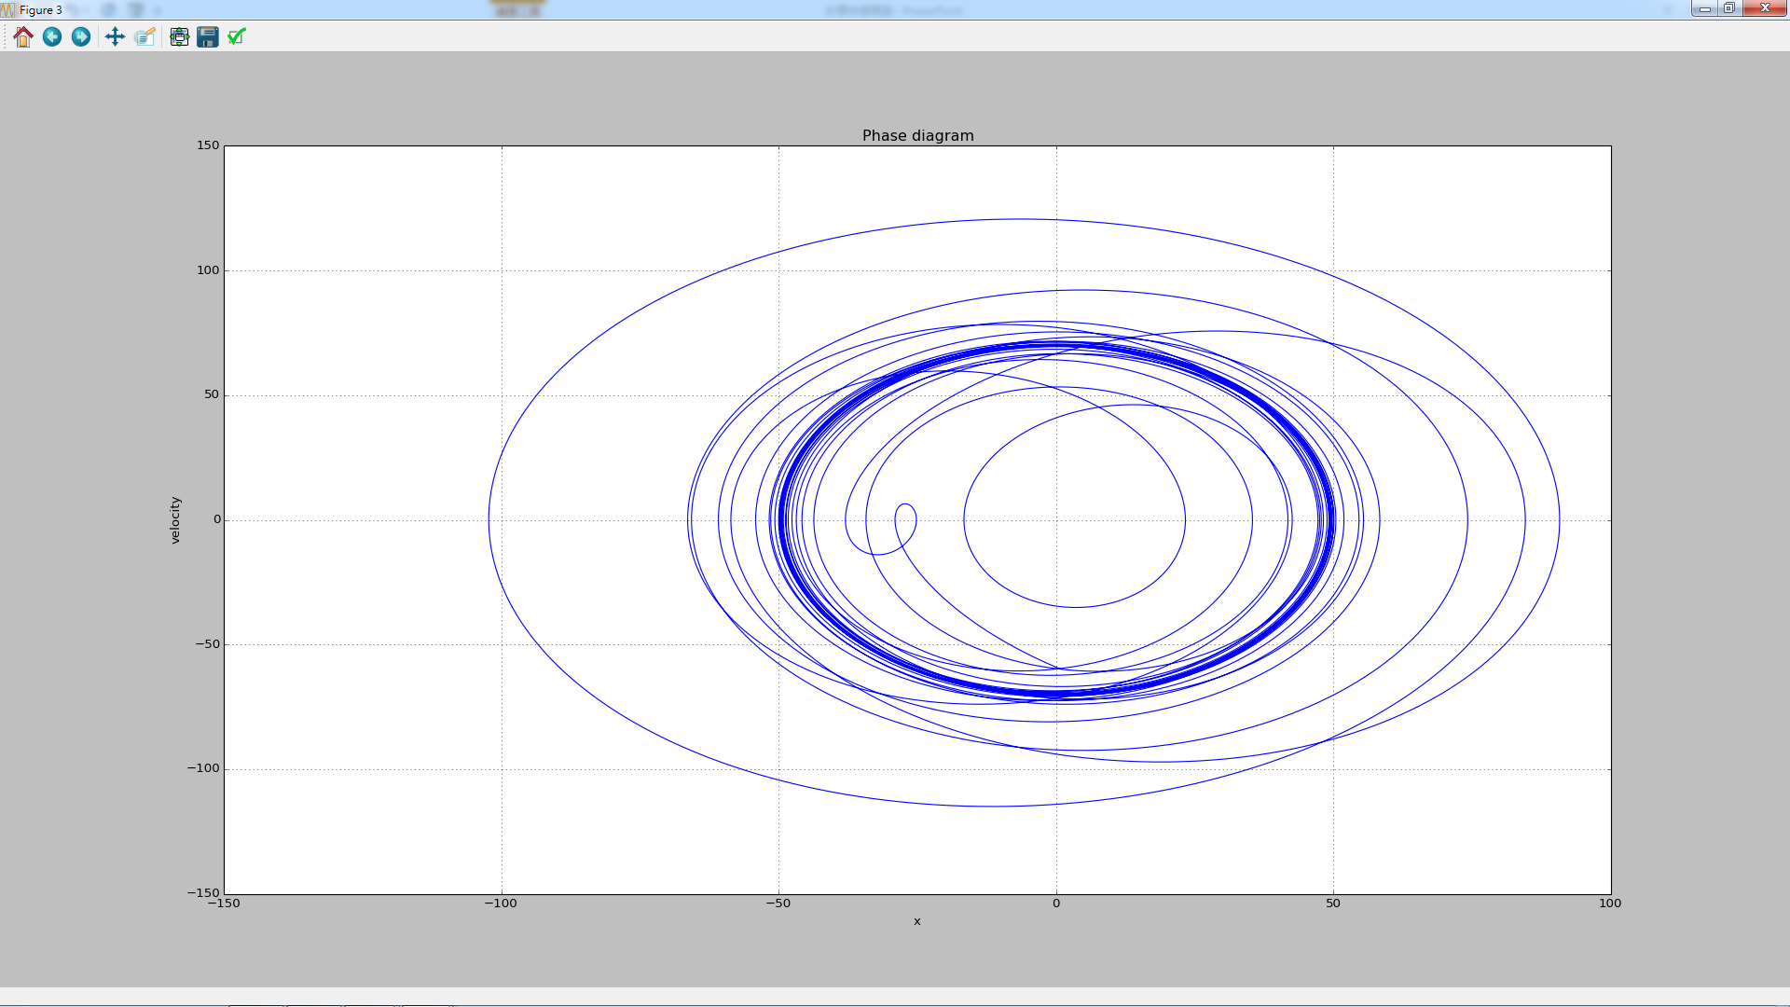
Driven SHM $ω=\frac{1}{\sqrt{2}}ω_{0}$

Slide 39
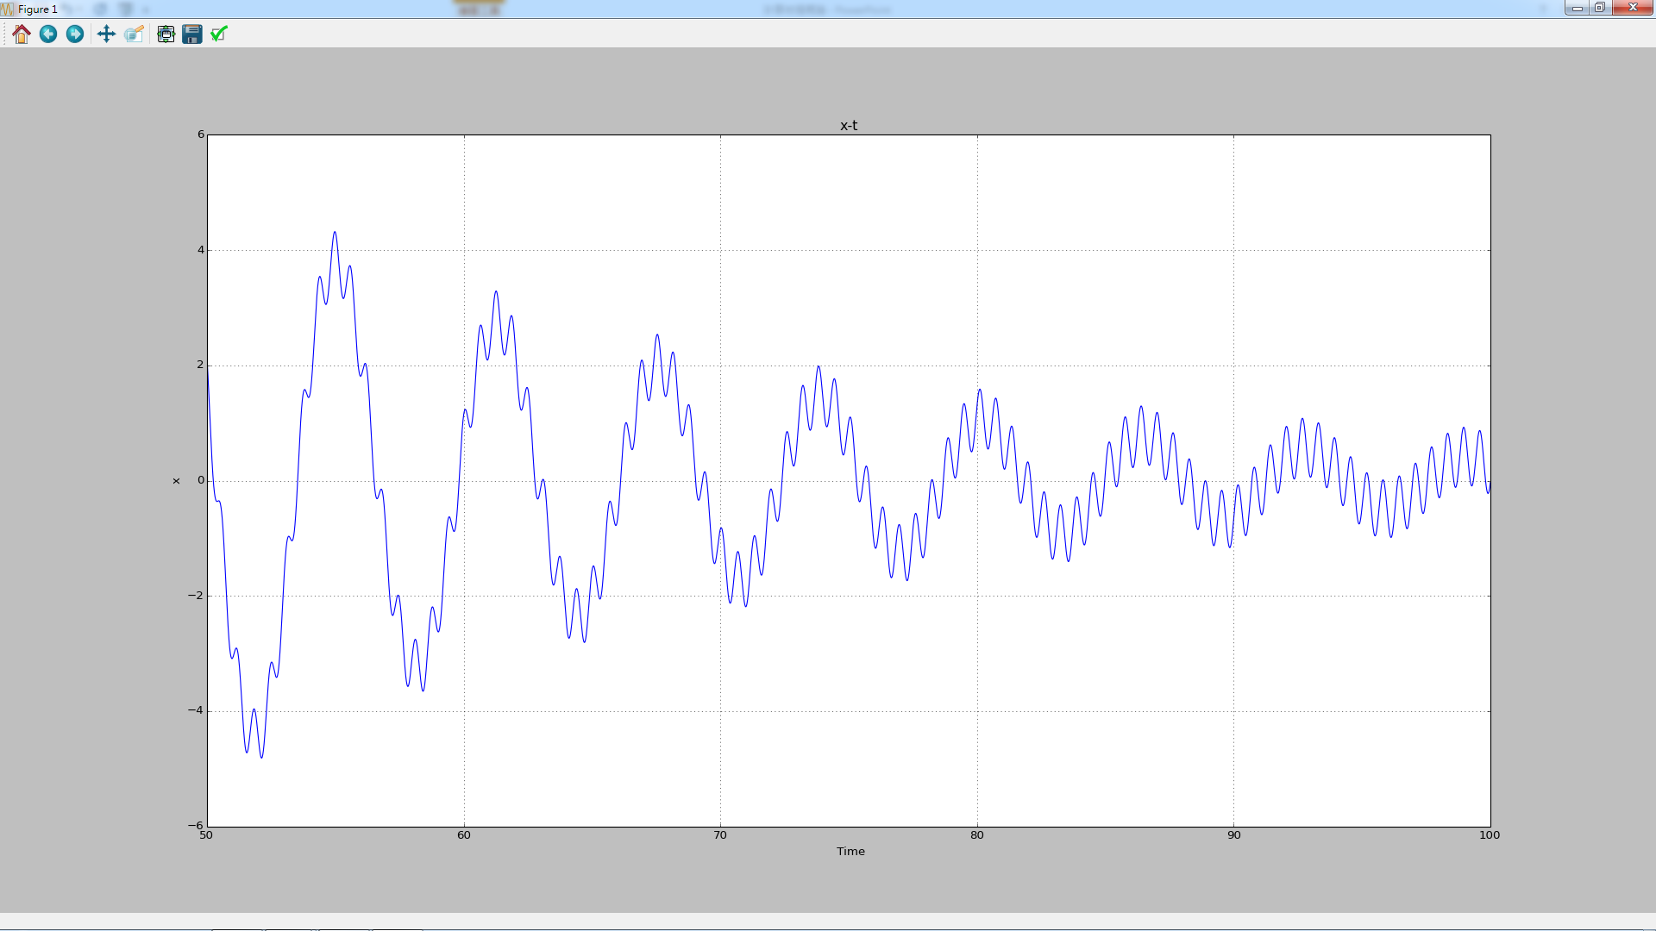

Driven SHM $ω=\frac{1}{10}ω_{0}$

Slide 40
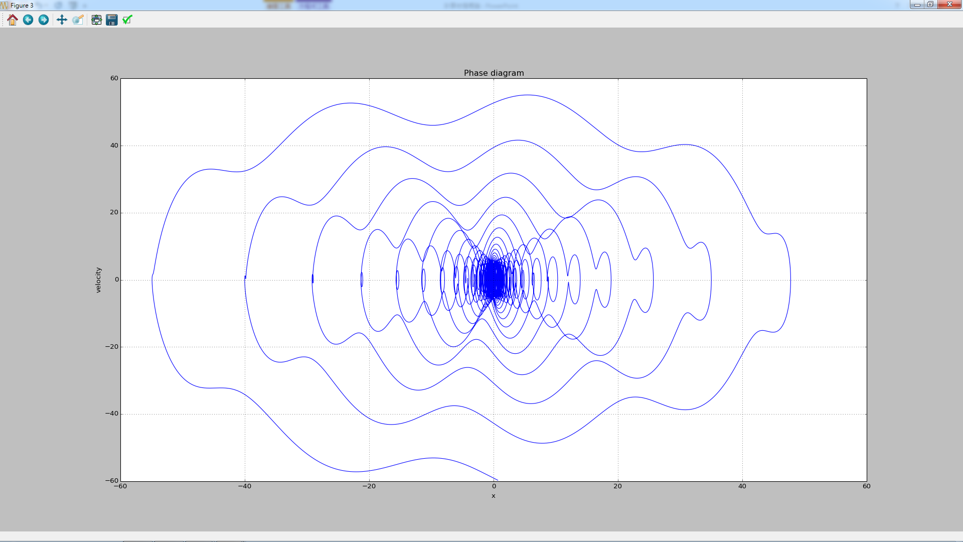
Driven SHM $ω=\frac{1}{10}ω_{0}$

Slide 41
Nonlinear Oscillator: Parameter
Xo=10
Vo=20
ω=2
Q=10

Slide 42
Nonlinear Oscillator: Code 1
#Nonlinear oscillator
#dx/dt=v
#dv/dt=-w*w*x-b*v
#Feynman Newton algorithm
from pylab import*
from math import*
x0=10
v0=20
w=2
Q=10
F=100

Slide 43
Nonlinear Oscillator: Code 2
t=0 #initial time
h=0.001 #time step size
T=1000
xdat=[]
vdat=[]#velocity data store here
time=[]#time stored here
v0=v0+h*(-x0-v0/Q)/2

Slide 44
Nonlinear Oscillator: Code 3
while(t<=T-200):
x1=x0+h*v0
v1=v0+h*(-x1**3+x1-v0/Q+F*math.cos(w*t))
x0=x1
v0=v1
t=t+h

Slide 45
Nonlinear Oscillator: Code 4
while(t<=T):
x1=x0+h*v0
v1=v0+h*(-x1**3+x1-v0/Q+F*math.cos(w*t))
xdat.append(x1)
vdat.append(v1)
time.append(t)
x0=x1
v0=v1
t=t+h

Slide 46
Nonlinear Oscillator: Code 5
figure(1)
title("x-t")
xlabel(" Time")
ylabel("x")
plot(time,xdat)
grid(True)
figure(3)
title("phase diagram")

Slide 47
Nonlinear Oscillator: Code 6
xlabel("x")
ylabel("velocity")
plot(xdat,vdat)
grid(True)
show()
print "(%g,%g)" % (xdat[T],vdat[T])

Slide 48
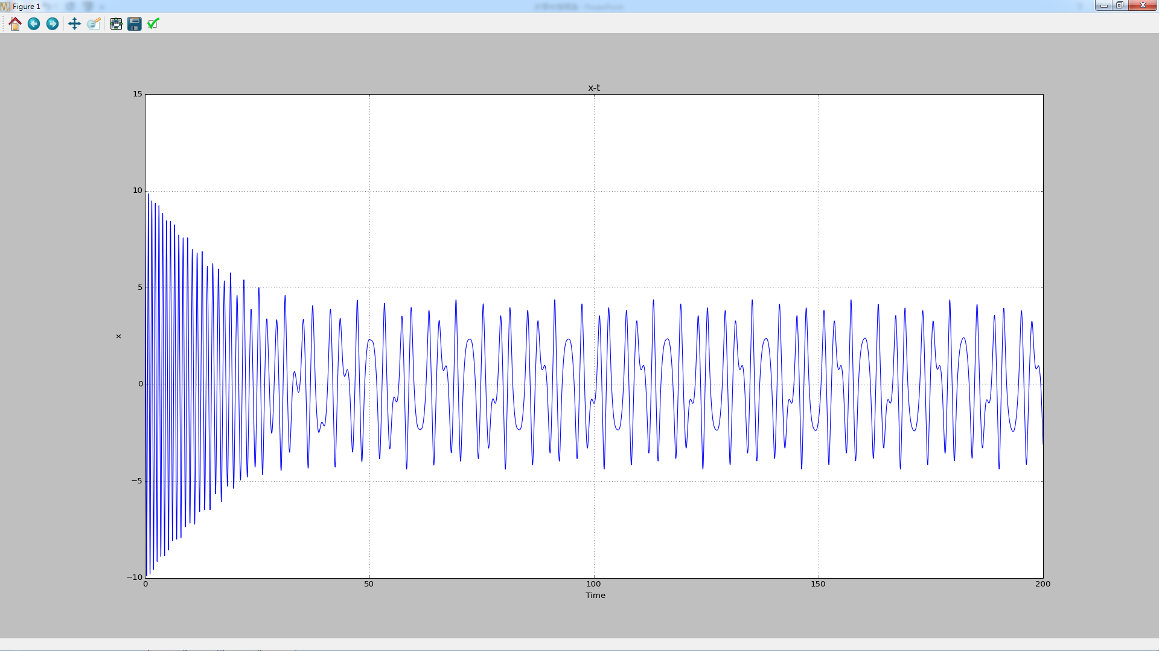
Van Del Pol oscillator F=10 T=0~200

Slide 49
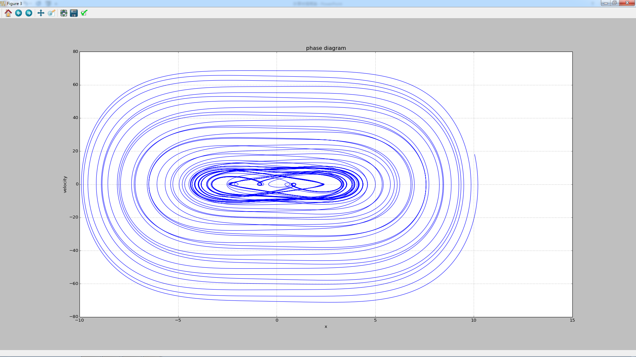
Van Del Pol oscillator F=10 T=0~200

Slide 50
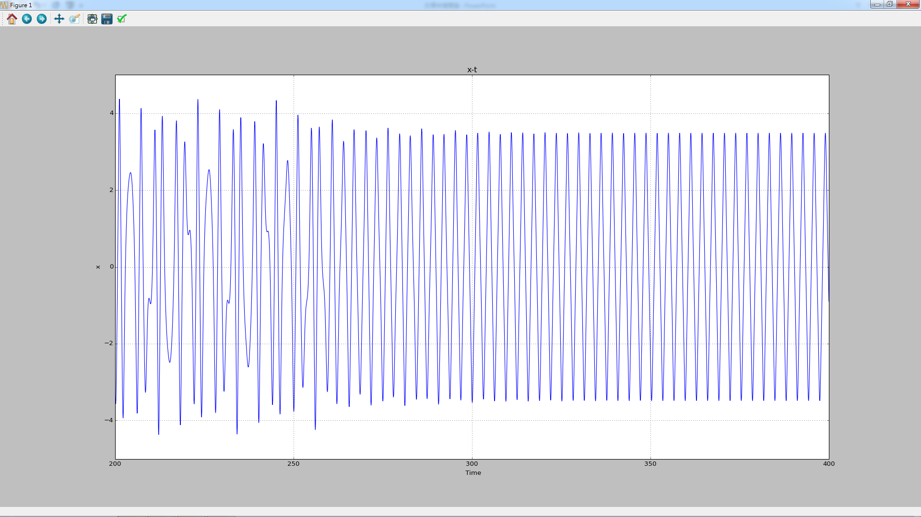
Van Del Pol oscillator F=10 T=200~400

Slide 51
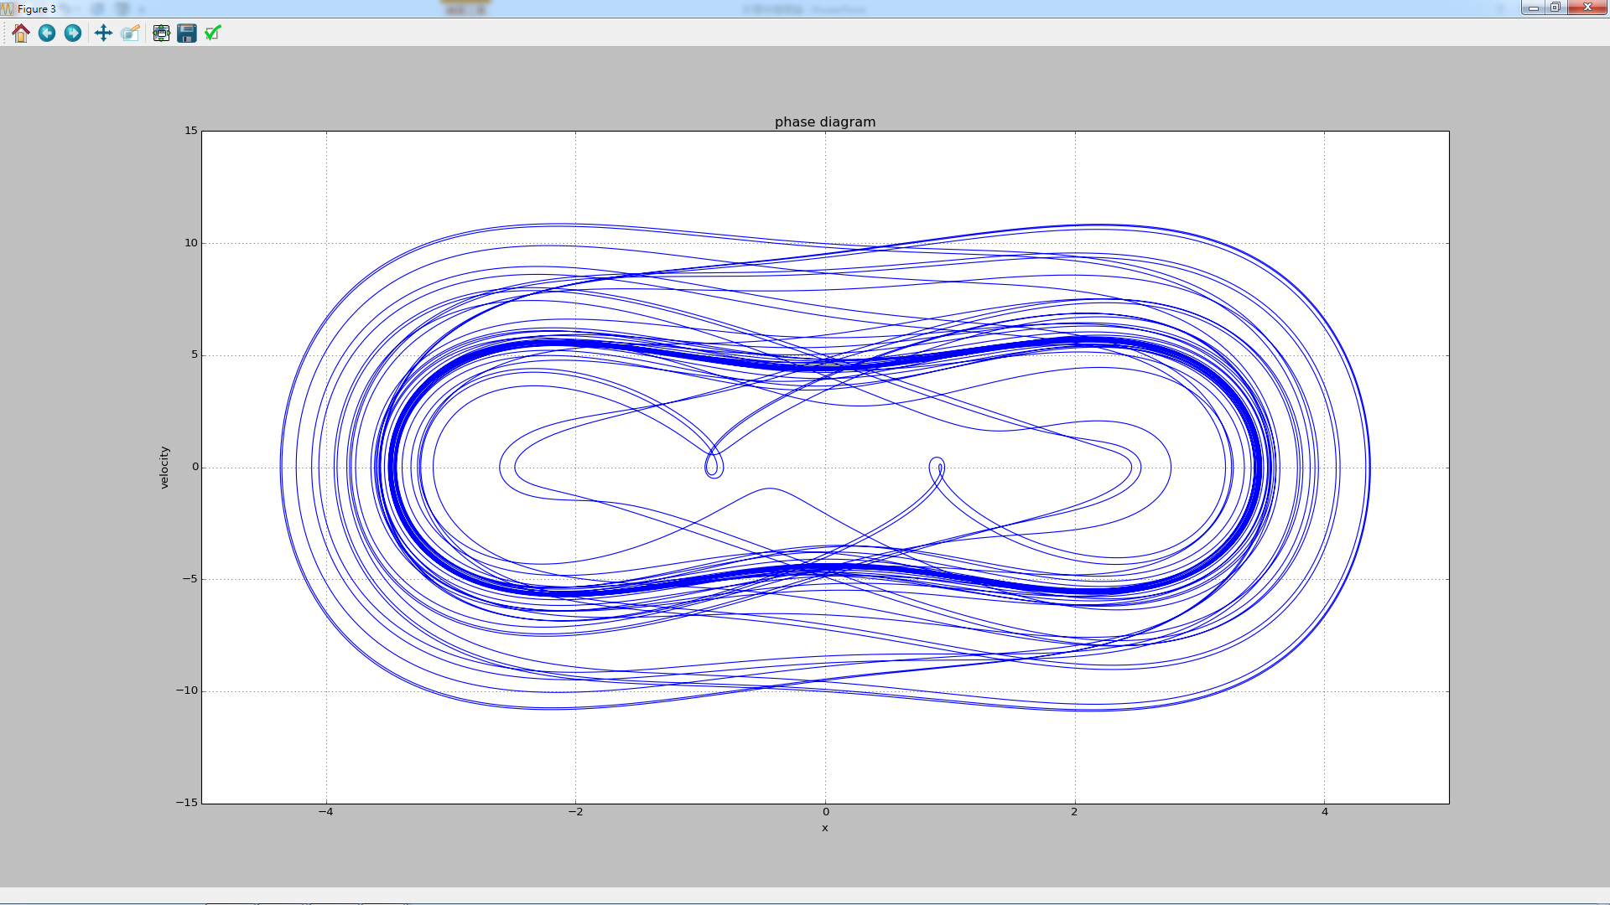
Van Del Pol oscillator F=10 T=200~400

Slide 52
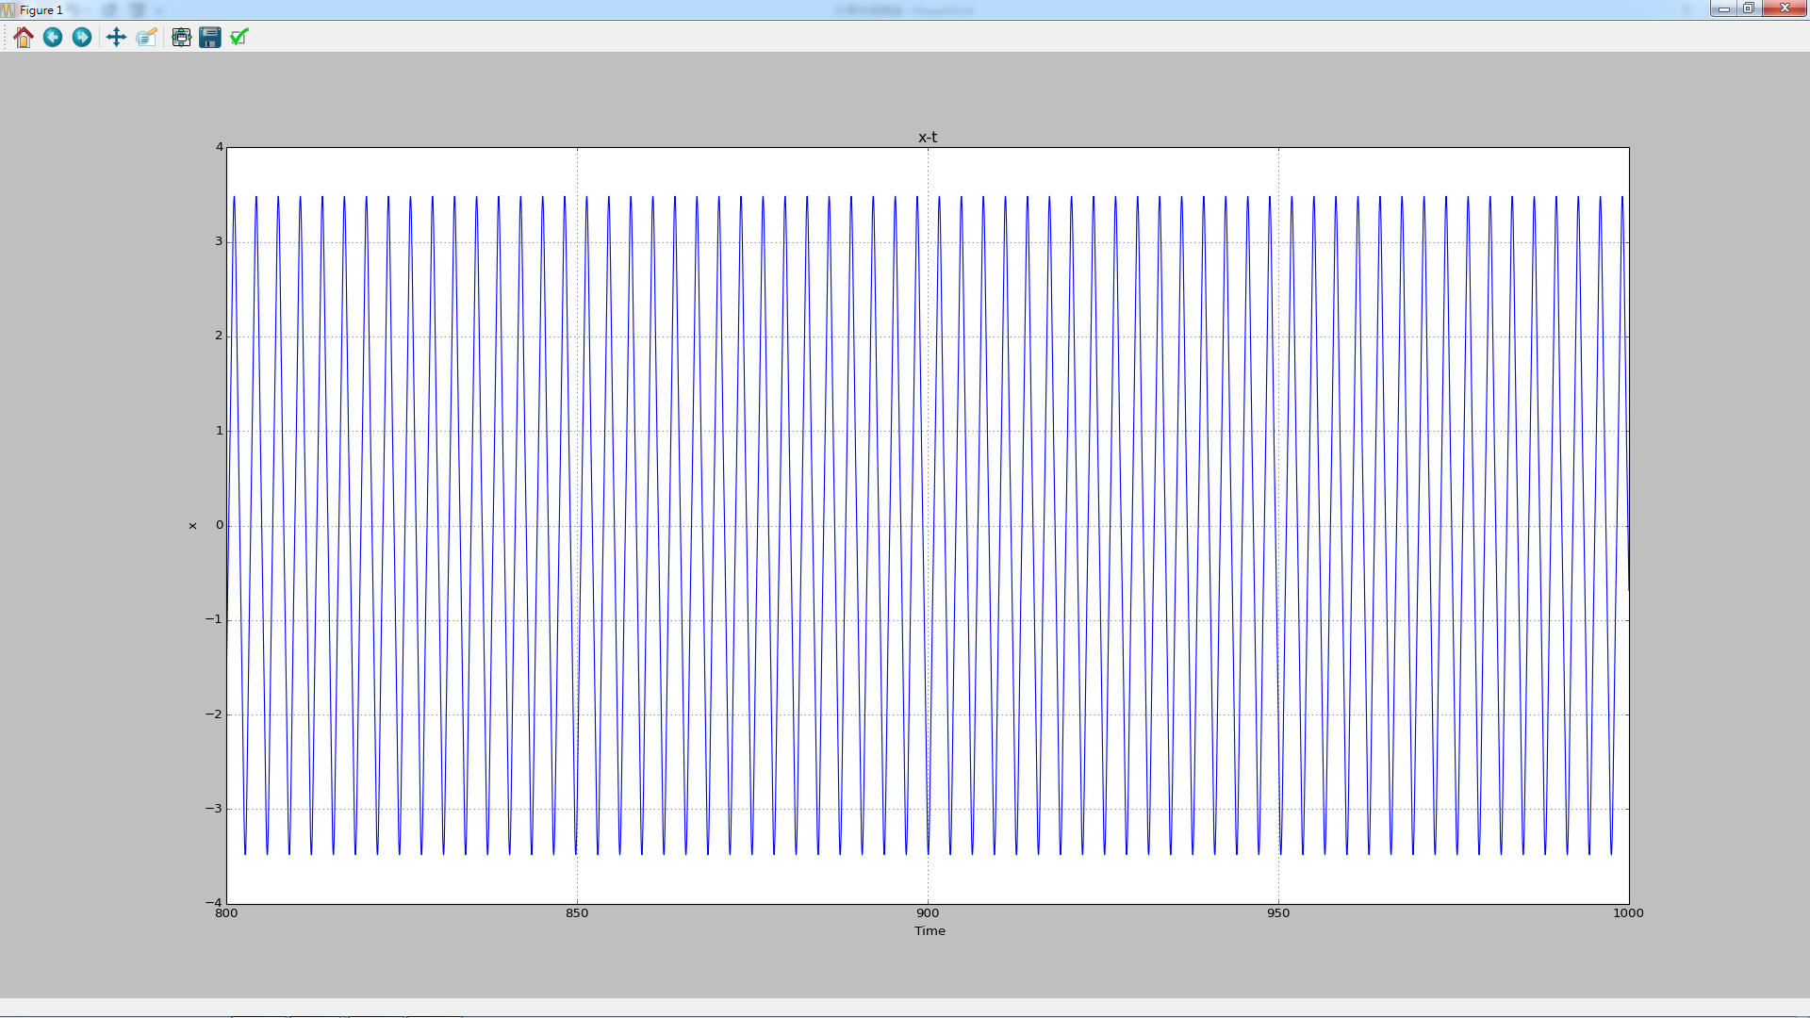
Van Del Pol oscillator F=10 T=800~1000

Slide 53
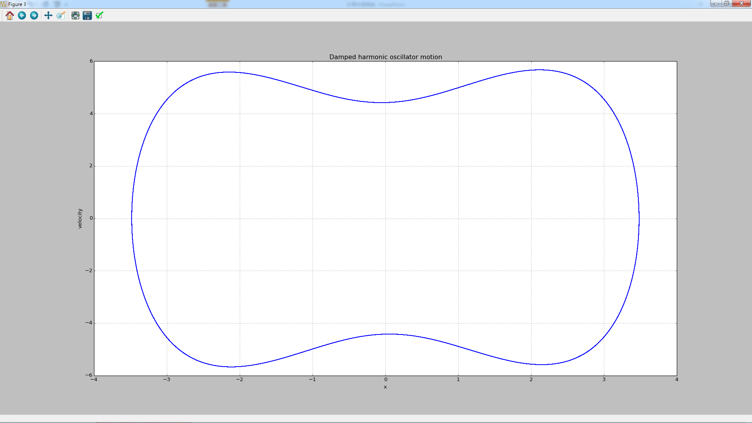
Van Del Pol oscillator F=10 T=800~1000

Slide 54
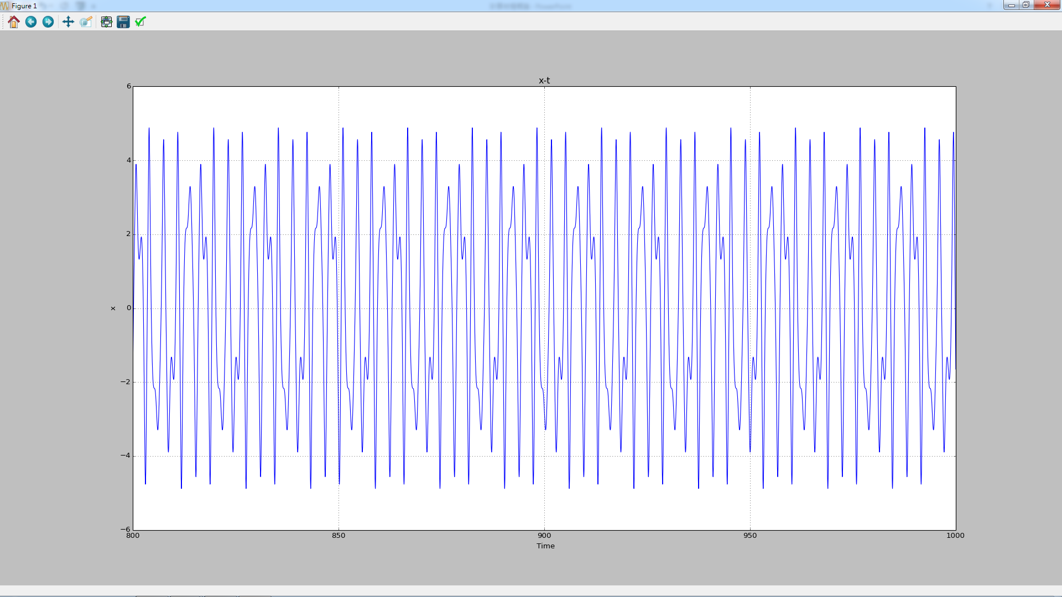
Van Del Pol oscillator F=20 T=800~1000

Slide 55
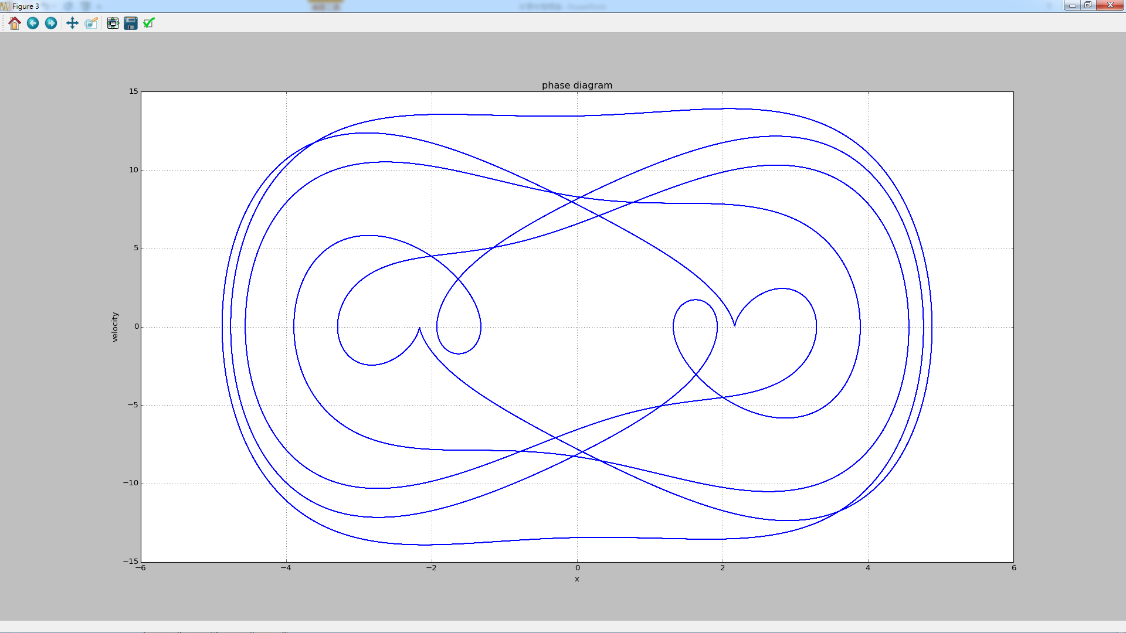
Van Del Pol oscillator F=20 T=800~1000

Slide 56
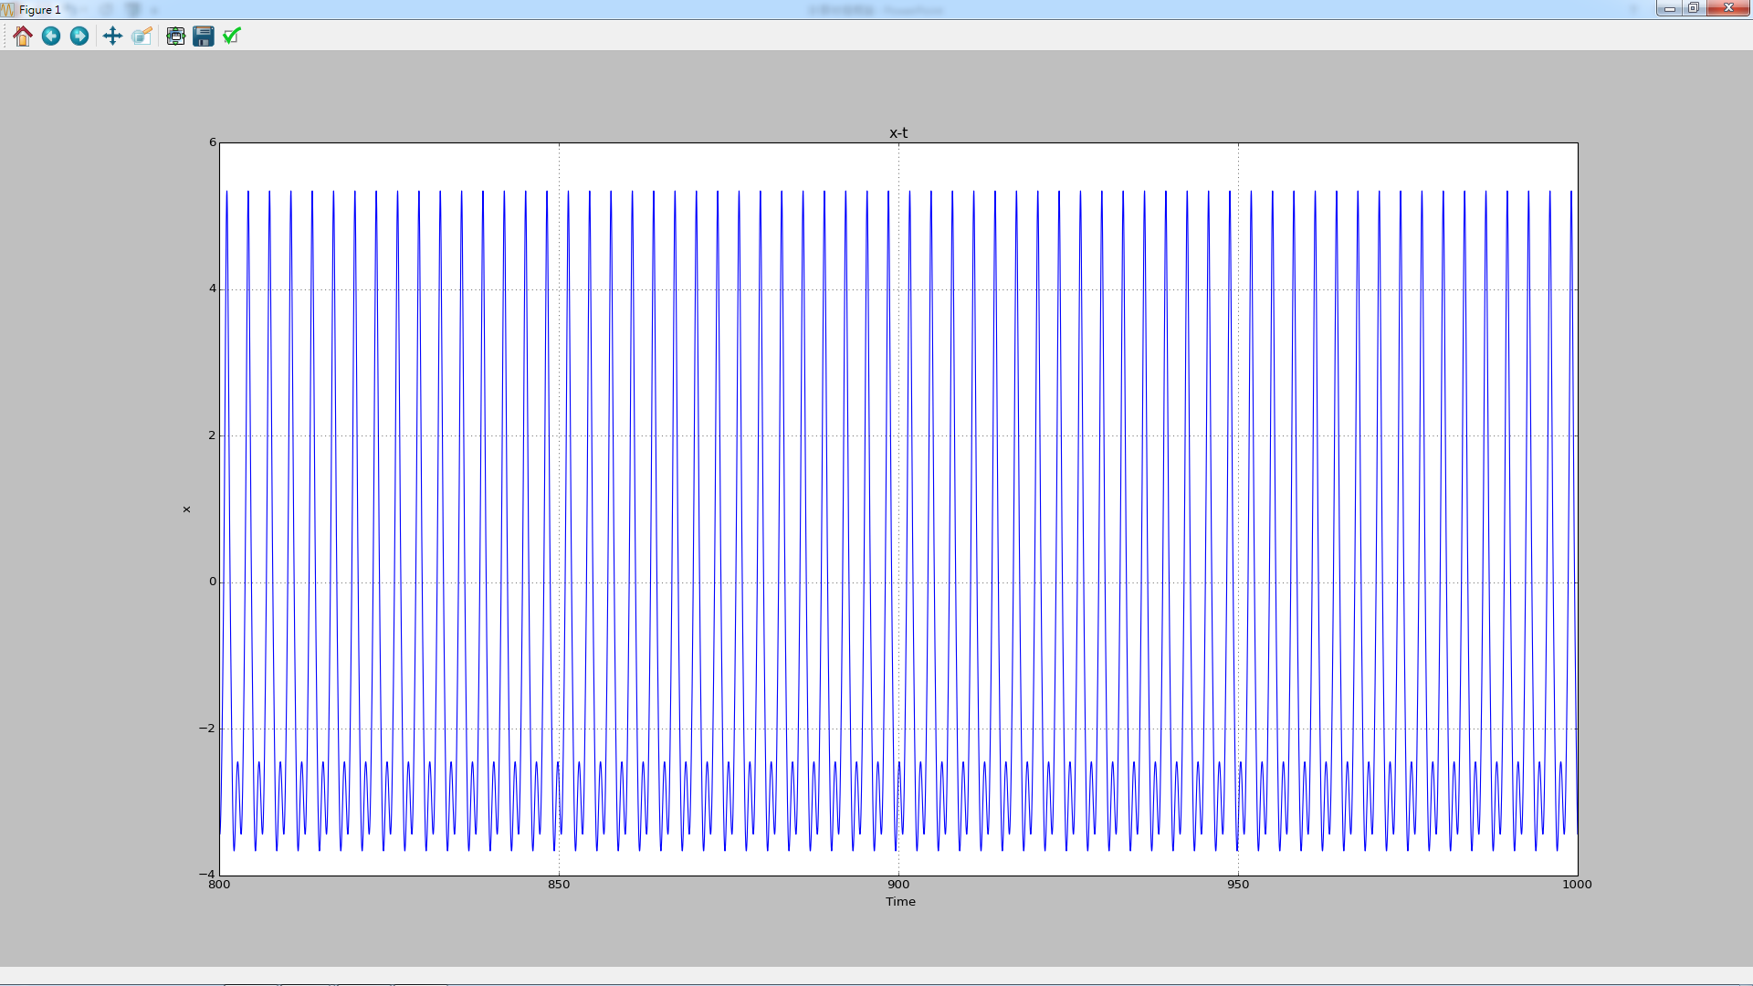
Van Del Pol oscillator F=30 T=800~1000

Slide 57
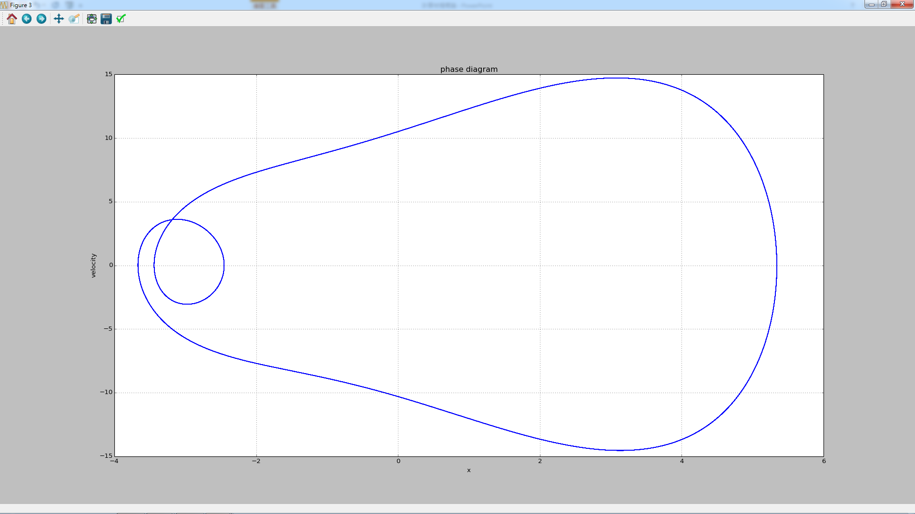
Van Del Pol oscillator F=30 T=800~1000

Slide 58
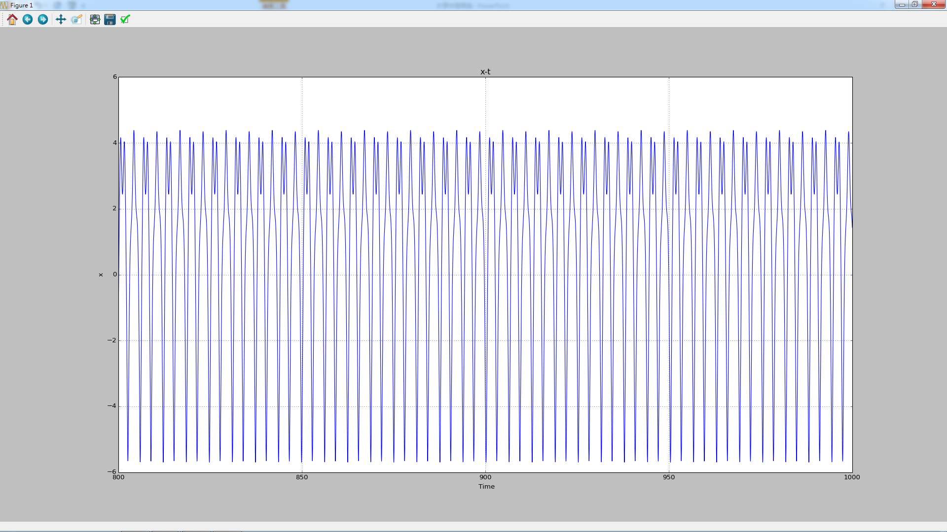
Van Del Pol oscillator F=40 T=800~1000

Slide 59
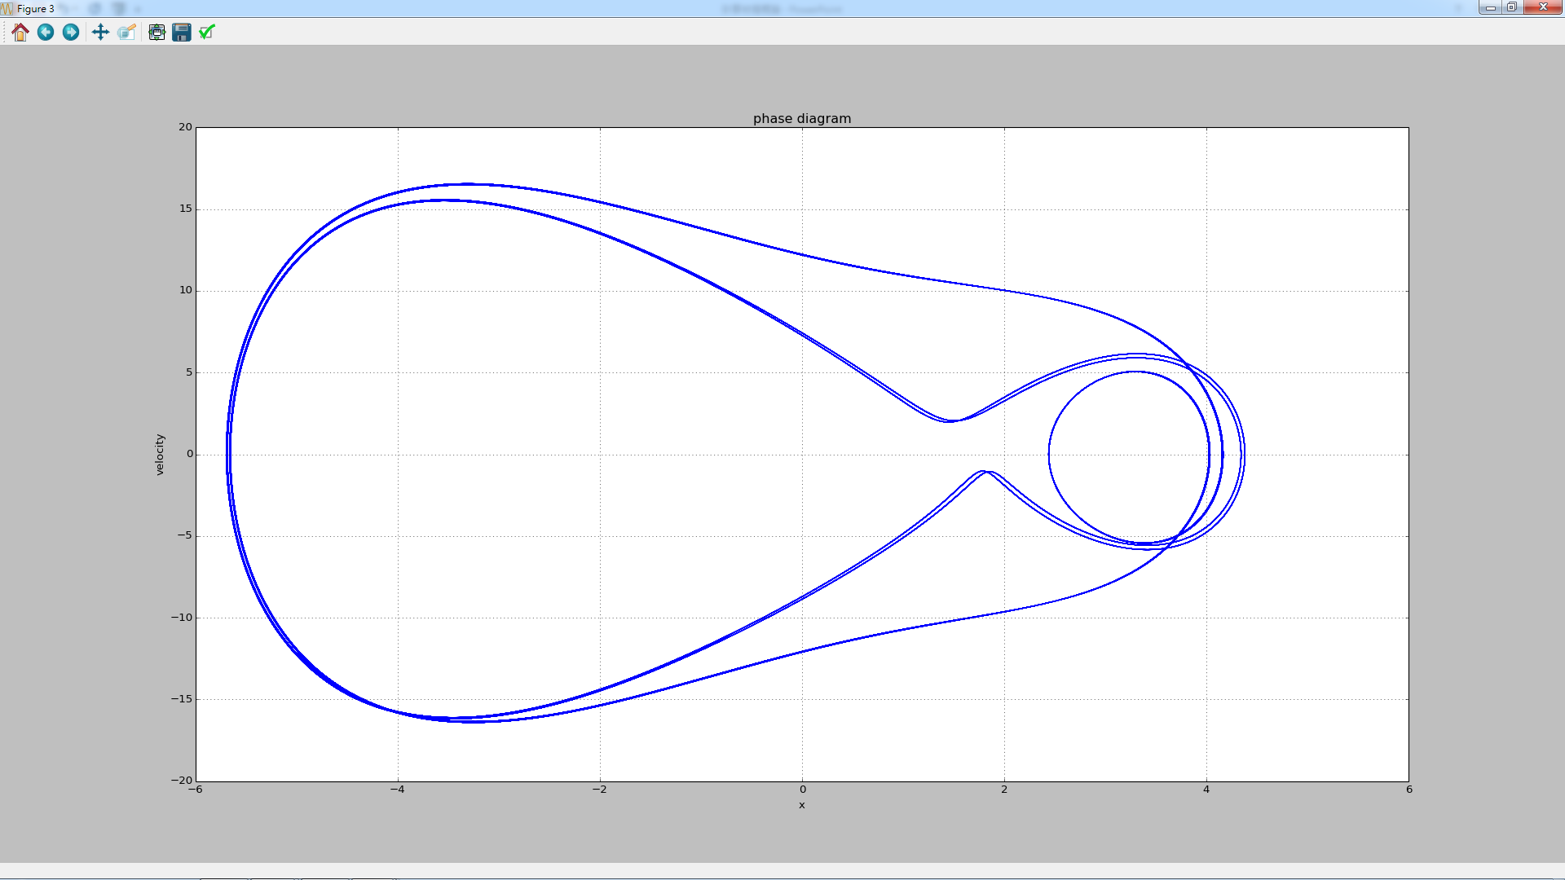
Van Del Pol oscillator F=40 T=800~1000

Slide 60
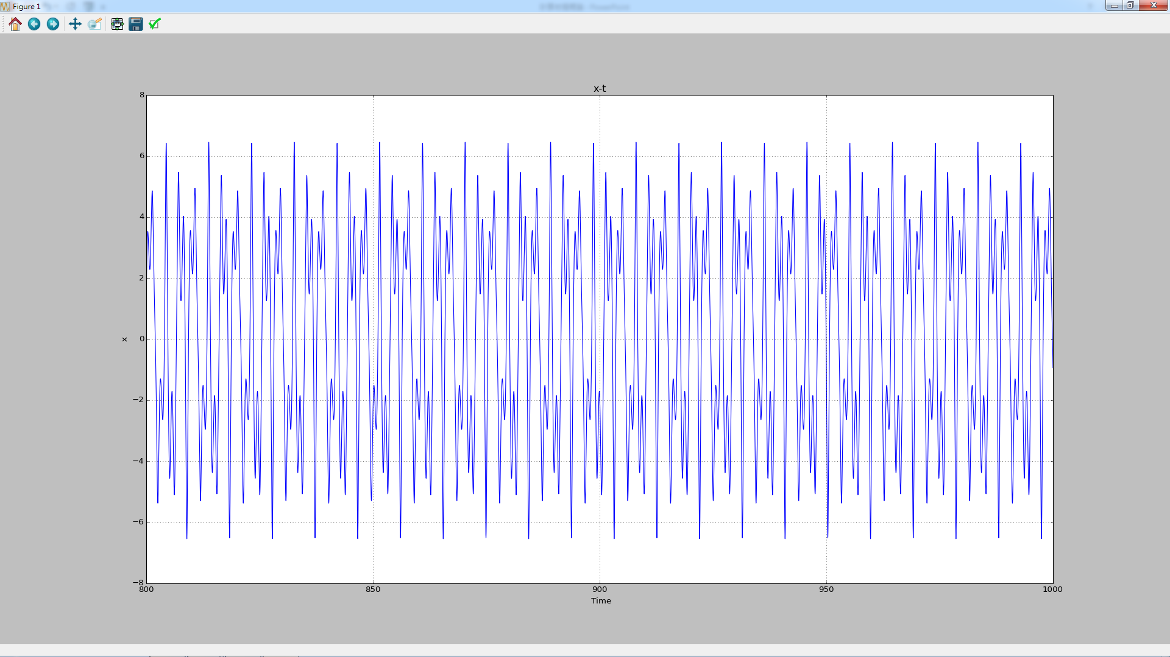
Van Del Pol oscillator F=50 T=800~1000

Slide 61
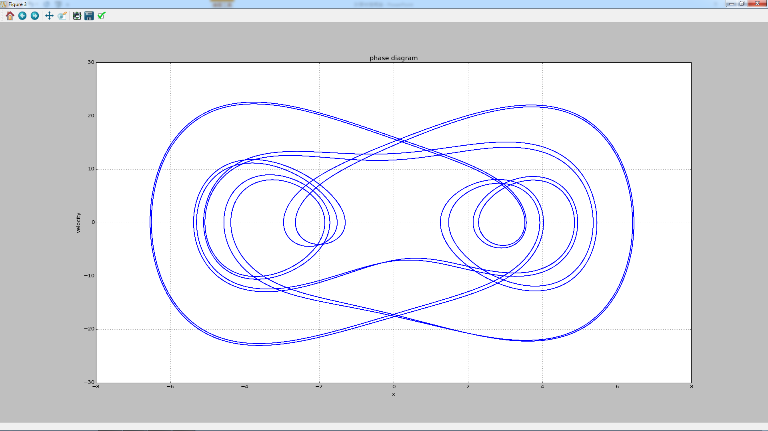
Van Del Pol oscillator F=50 T=800~1000

Slide 62
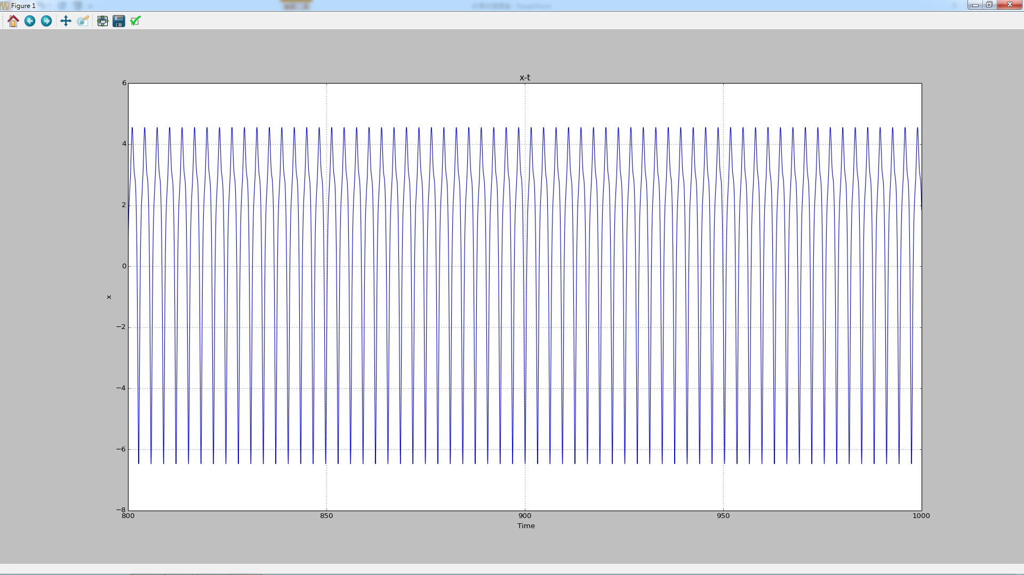
Van Del Pol oscillator F=60 T=800~1000

Slide 63
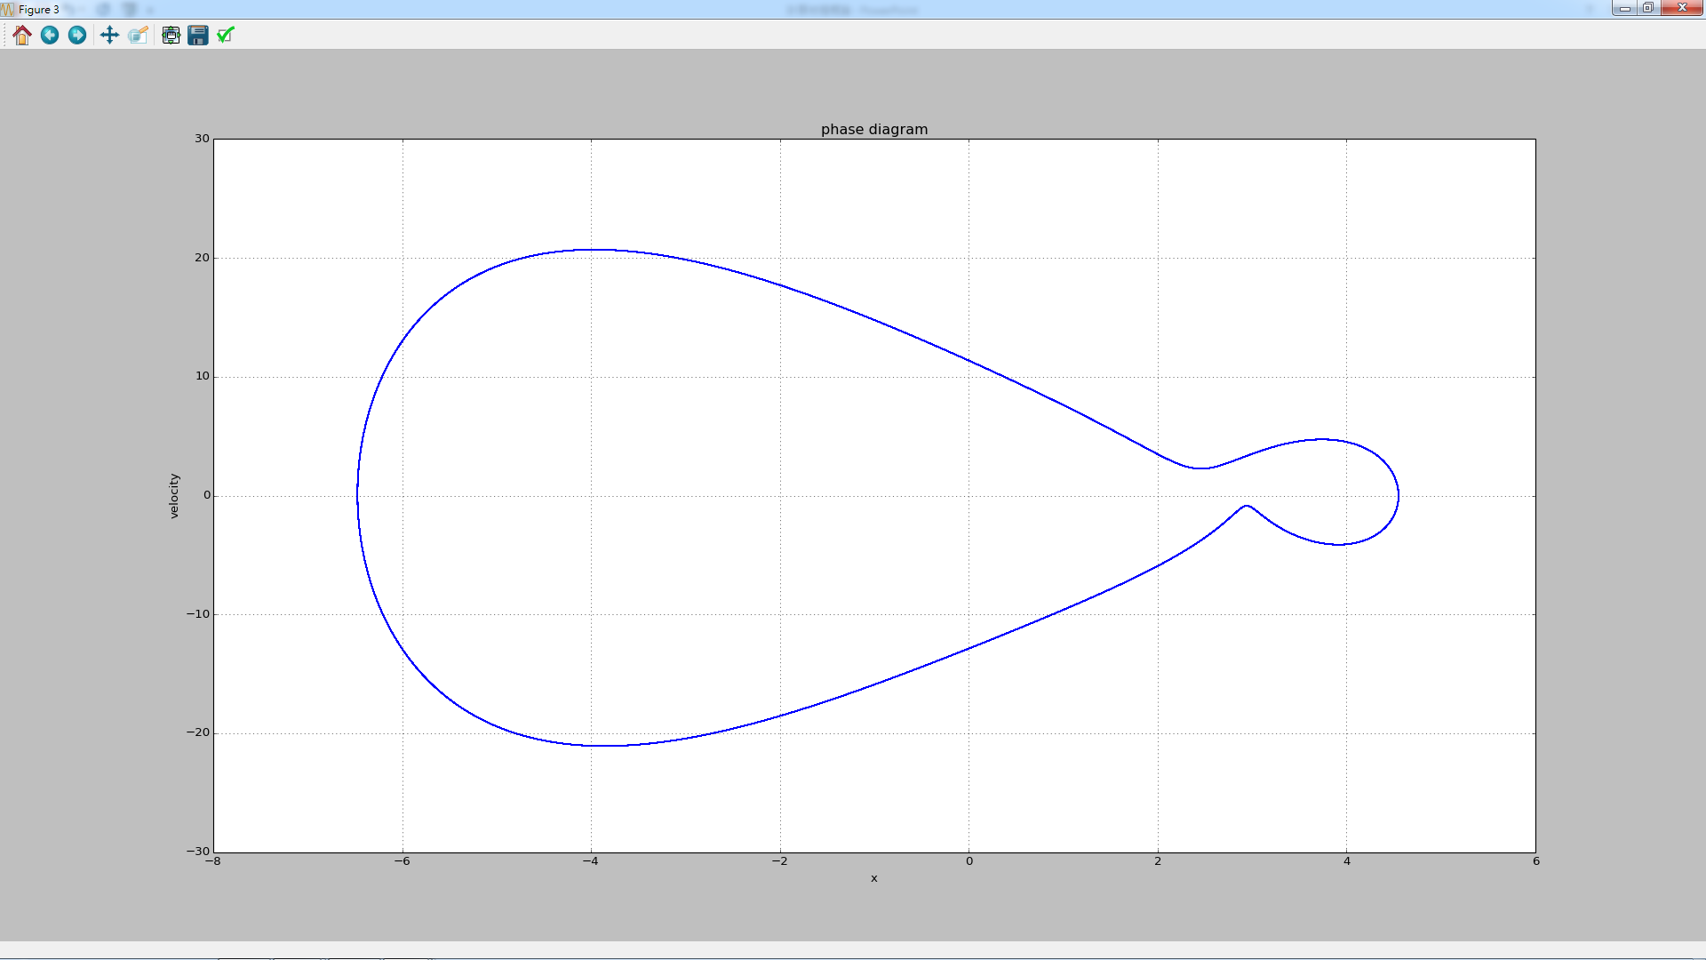
Van Del Pol oscillator F=60 T=800~1000

Slide 64
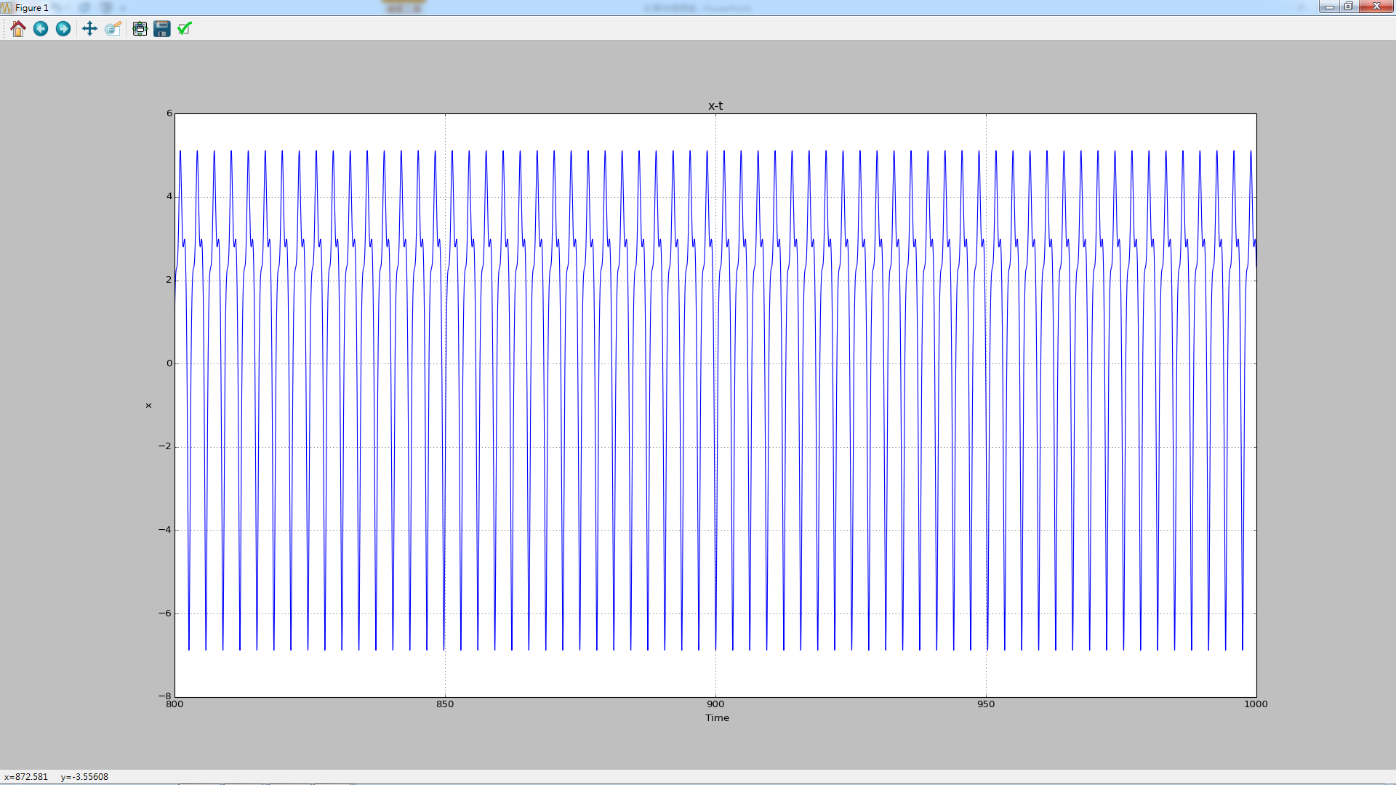
Van Del Pol oscillator F=70 T=800~1000

Slide 65
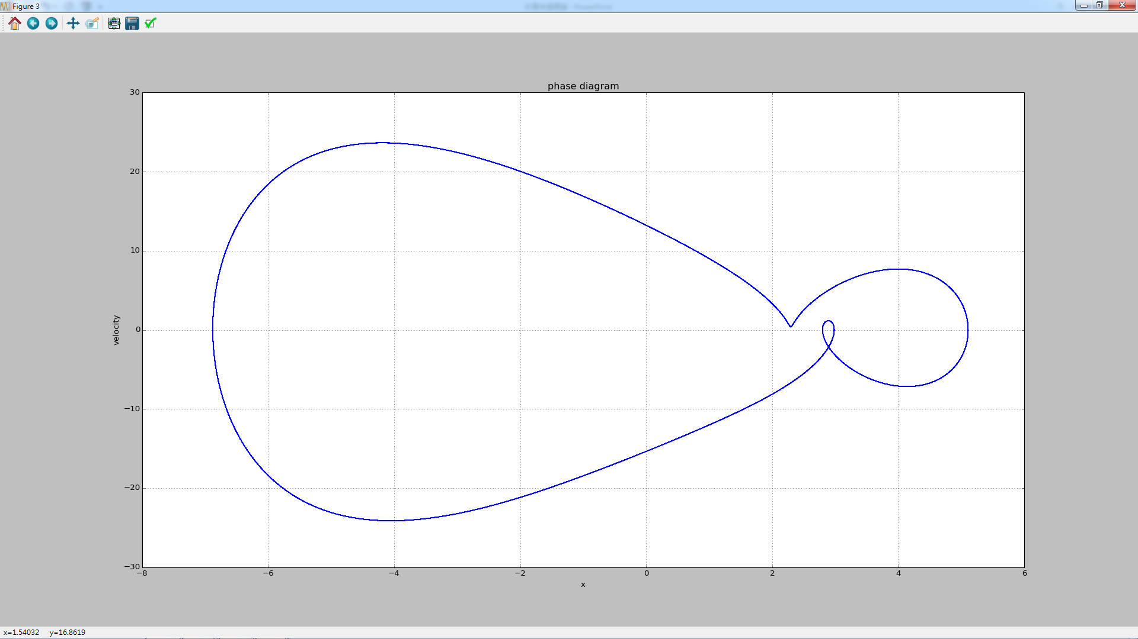
Van Del Pol oscillator F=70 T=800~1000

Slide 66
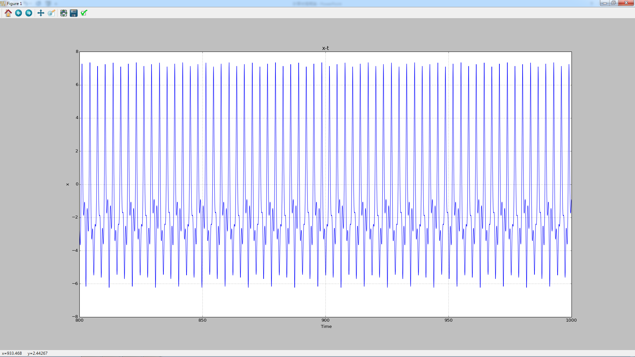
Van Del Pol oscillator F=80 T=800~1000

Slide 67
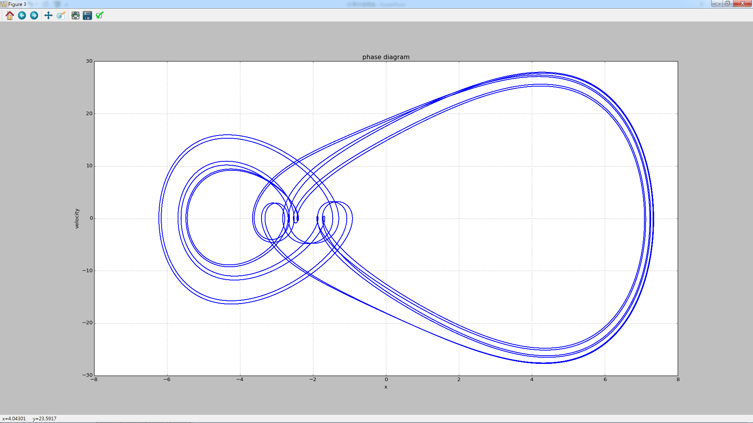
Van Del Pol oscillator F=80 T=800~1000

Slide 68

Van Del Pol oscillator F=90 T=800~1000

Slide 69

Van Del Pol oscillator F=90 T=800~1000

Slide 70

Van Del Pol oscillator F=100 T=800~1000

Slide 71

Van Del Pol oscillator F=100 T=800~1000

Slide 72
參考資料
Classical Dynamics of Particles and Systems, Thronton and Marion, 5ed, pp. 99-137
Classical Dynamics of Particles and Systems, Thronton and Marion, 5ed, pp. 144-78

Slide 73
Thank You!

